Slide 1
Sainik School Gopalganj
Chapter One
Class IX

Slide 2
Representing real numbers on number line by successive magnification
1. Representing Real Numbers on the Number Line by Successive Magnification.
2. NUMBER LINE • In mathematics, a number line is a picture of a straight line on which every point is assumed to correspond to a real number and every real number to a point. 0 1 2 3 4 5-1-2-3-4-5
3. WHAT IS SUCCESSIVE MAGNIFICATION? • The process of visualization and representation of real numbers on the number line through magnifying glass is known as successive magnification. 0 1 2 3 4 5-1-2-3-4-5 • Basic Number Line :- • Suppose we want to magnify the portion between 1 and 2:- 0 1 2 3 4 5-1-2-3-4-5 • Magnification:- 1 21.51.1 1.2 1.3 1.4 1.6 1.7 1.8

Slide 3
Representing real numbers on number line by successive magnification
PROCEDURE • To represent 5.2316 on a number line :- • Step 1 :- locate the range of the number. 0 5 The number lies between 5 and 6 -3-6 1 2 3 4 6 7 8-1-2-4-5-7-8
5. • Step 2 :- Now let us look closely at the portion of number line between 5 and 6. Suppose we divide it into 10 equal parts and then mark first point to the right of 5 will represent 5.1, the second as 5.2 and so on. 5 6 5.1 5.2 5.3 5.4 5.5 5.6 5.7 5.8 5.9 Lies between 5.2 and 5.3
6. • Step 3 :- Now let us magnify the portion which lies between 5.2 and 5.3 . Again divide the line into 10 equal parts, the first mark will represent 5.21 and the second as 5.22 and so on. 5.2 5.3 5.255.21 5.22 5.23 5.24 5.26 5.27 5.28 5.29 Lies between 5.23 and 5.24
7. • Step 4 :- Now let us magnify the portion which lies between 5.23 and 5.24 , again divide the line into 10 equal parts, the first mark will represent 5.231 and the second as 5.232 and so on. 5.23 5.245.235 5.231 5.232 5.233 5.234 5.236 5.237 5.238 5.239 Lies between 5.231 and 5.232

Slide 4
Representing real numbers on number line by successive magnification
Step 5 :- Now let us magnify the portion which lies between 5.231 and 5.232 , again divide the line into 10 equal parts, the first mark will represent 5.2311 and the second as 5.2312 and so on. 5.231 5.2325.23155.2311 5.2312 5.2313 5.2314 5.2316 5.2317 5.2318 5.2319 Finally the number 5.2316 lies in here.
9. SUMMARY • Each real number corresponds to exactly one point on the number line. • Every point on the number line represents a real number. • Infinite real numbers can be drawn on a number line. • The point on the line that is associated with a point on the number line is called the coordinate of the point.
10. CONCLUSION :- In the light of the discussion above and visualisation, We can say that every real number is represented by a unique point on the number line. Further, every point on the number line represents one and only one real number.

Slide 5
Representing real numbers on number line by successive magnification

Slide 6
How do you draw an irrational number?
Who is Theodorus off Cyrrene?
Drawing the Wheel of Theodorus
Math into Art
What can we learn from the Wheel of Theodorus?

Slide 7
How do you draw an irrational number?
STEPS :
On the corner of your notecard,measure one inch on each side.
Place the notecard in the CENTER of your white paper. Trace the corner of your paper so you create a right angle.
Use your note card as a straight edge and close off your right angle by drawing the hypotenuse.

Slide 8
How do you draw an irrational number?
Now find the length of the hypotenuse using the Pythagorean Theorem. Make sure to show your work on a separate sheet of paper.
Line up your note card along the hypotenuse. Trace only the bottom of the note card to create another right angle.
Draw in the hypotenuse. You are on your way to drawing the Wheel of Theodorus.

Slide 9
FINISHING THE WHEEL:
Continue making right triangles until you have AT LEAST ten. For each of these ten triangles make sure that you continue to show your work for finding each new hypotenuse. You may make more triangles, but you only need
calculations for the first ten.

Slide 10
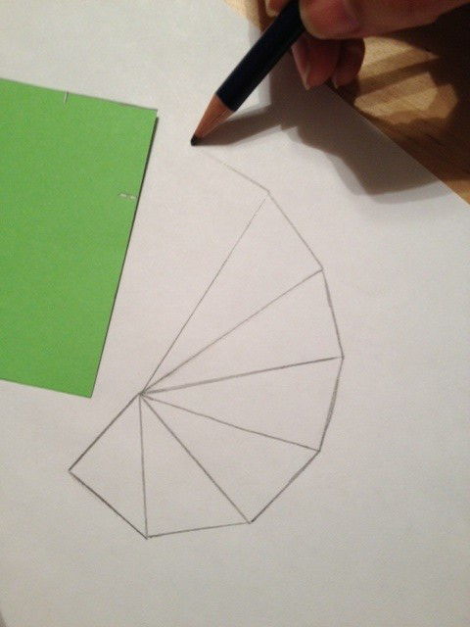

Slide 12
Thank you

